Slide 1
PROMOTION REPORT
1/10
INCREASE EFFICIENCY
BY AUTOMATION EQUIPMENT
CONTENTS:
1
JOB DESCRIPTION
Page 1-2
2
ACHIEVEMENT
Page 3-4
3
PENDING ISSUES
Page 5
4
ACTION PLAN
Page 6-8
5
DEVELOPMENT PLAN
Page 9-10
Present by : Nguyen Ba Thang
Join Date : 01st Nov 2007
Current Position : Supervisor
New Position : Assistance Manager
Section : Production Engineering
Notes:
Good afternoon Sir,
My name Ba Thang, from PE section
Today , I am very happy to standing here to present my report
My report have 5 main content
With theme is: Increase efficiency by automation equipment

Slide 2
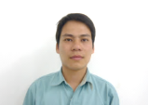
1. JOB DESCRIPTION
2/10
Current organization chart
Responsibility
GM
Mr. Kihara
DP
New model:
Prepare equipment
Setup line, process
Transfer subcontractor
Control equipment:
Capacity, Efficiency
Technical training
Solving troubles, improvement
Localization
■ Assist to Manager:
Design process, layout, working schedule...
Negotiate with other section.
CPT
M
Mr. Nhuong
SUP (E)
Nguyen Ba Thang
HD COM
(07 staffs)
SCN, B-FAX
E-DESIGN
Addition
M-DESIGN
PBX, AIO
DECT
CONTROL
STD TIME
FACILITY
Notes:
Firstly, I would like to show you my current job
Now I am in charge 4 category and electrical design
My job is preparing new model and setting up production line,
Control equipment capacity, efficiency
And together with design team develop PSNV equipment
I also support to Manager and GM to design layout, make schedule
And to discus with other section about equipment capacity
In new position, beside current job, I will in charge more 4 team.

Slide 3
2. ACHIEVEMENT
3/10
2.1. Set up and transfer over 50 new models successfully
CATEGORY | DP | CPT | HD-COM | SCANNER | B-FAX
MODEL | VL-SV21/26 VL-SW251 | JT-C16 JT-C17 | KX-VC1300 KX-VC1600 | S1057/S1027 S40/70 | UF-8600
2.2. Reduce investment by PSNV localization
No | Machine name | Q’ty | PSN Unit Price (USD) | PSNV Unit Price (USD)
1 | Setting base | 35 | 1,066 | 450
2 | Pushing panel | 60 | 1,200 | 650
3 | Soldering Jig | 50 | 1,200 | 280
4 | RF checker | 37 | 4,111 | 2,200
5 | Straight cutter | 9 | 4,500 | 1,820
6 | Hand press | 65 | 4,800 | 1,109
7 | ID writer | 45 | 5,800 | 800
8 | Acoustic | 11 | 12,000 | 4,000
Total price |  |  | 1,066,917 | 318,615
Total save cost
$750,000
$
Notes:
Next, I would like to show you some achievement in my job,
I have 3 achievement
The first, I completed set up and transfer over 50 new model
The second, together with design team
I made and designed almost checker, jig for new model
With this quantity, if we buy from PSN we spend 1 million dollar
And compare with PSNV, we save cost about 750 thousand dollar
Especially, Acoustic and ID writer we cost down 66%

Slide 4
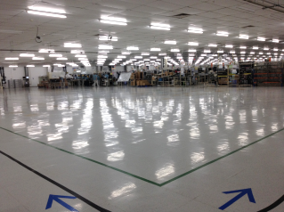
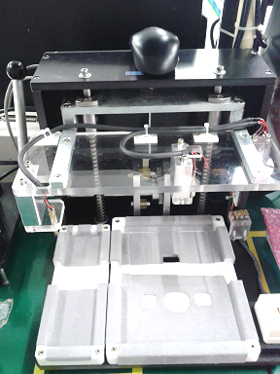
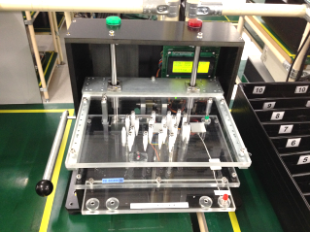
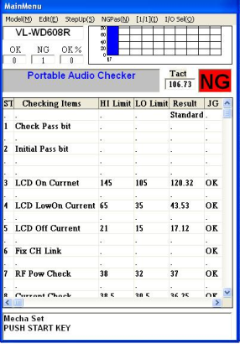
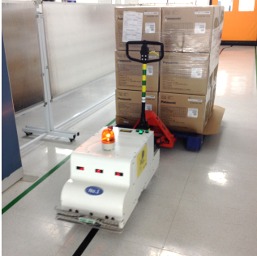
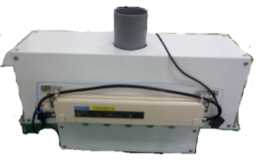
2. ACHIEVEMENT
4/10
2.3. Increase efficiency and cost down
Action
Time
Effective
Actual condition
◆ Improvement factory
1. Change layout
DP, CPT
2. Combine jig
ID writer
Acoustic checker
FY2014
Save space
2nd fl: 670m2
Cost down
$5K/set
$8K/set
HS
BASE
◆ Improverment skill
1. Make FCT Checker
DP checker Wiring
2. Modify checker software
Set up and start up
FY2014
Cost down
❐ $196.8K/Y
OK
◆ Cost buster
1. Make PCB Cleaner
ALL Install SMT Line
2. Make AGV
2 Set Install
100% System control
FY2014
30set
Cost down
$4K/2Robot
2person
(=$18.2K/Y)
FY2014
2robot
Notes:
The third is some activity to increase efficiency and cost down.
Contain Improve factory, skill and cost buster
Together production side to change layout and combine checker
Total save space over 600 m2
We made checker for new model, wiring and debug software
Totally we save cost near 200000 dollar
About cost buster activity, we made PCB cleaner and
perform Kamogawa san’s ideas about AGV- transport station robot
For AGV, we designed and made 2robot, save cost 4000 dollar
Reduce 2 person, so every year save 18000 dollar
Let me go to next slide

Slide 5
3. PENDING ISSUES
5/10
MANUAL PROCESS NEED TO BE REDUCED
1.1.Low Efficiency | Take too much time for confirm Operation not reasonable | Automation to 1.REDUCE MISTAKE 2.INCREASE EFFICIENCY
1.2.Low Quality | LED no light. Wrong battery polarity, key. Wrong LCD panel
2.Localization | Mechanical: 70% Electrical, software : 20% | Develop electrical design to increase 50% localization
Localization ratio
More Automation and Localization
Action for
pending issue
Notes:
Because, PE main in-charge equipment
So we always thinking how to keep equipment in good condition
And how to improve it become more and more perfect
During I work, I have some pending issues as below
I see that in production line have many manual process
It is the one of reason to make low efficiency and low quality
And this year we perform localization activity,
almost of mechanical part was designed and processed in PSNV
However, we still have import many from oversea, for example: Control Box, Software etc.
Let me go to next page

Slide 6
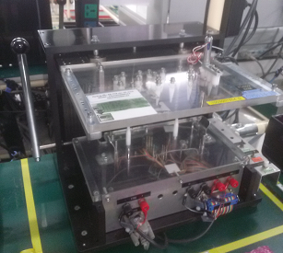

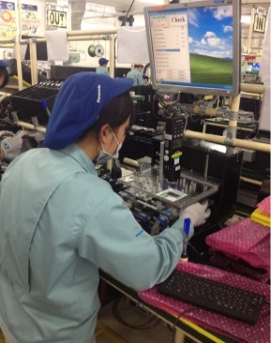
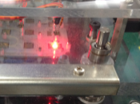
4. ACTION PLAN
6/10
■ Action1 ⇨ Increase efficiency
Item
Action
Effective
Time
Actual product
◆ Reduce manual operation at checker
1. Add auto start fuction
2. Add confirm LED
Cost down
$3.3K/Y
Save time
❐ 7.5s/pcs
Apply
DP: 8lines
Expantion to DECT, PBX
From
MAY
2015
E-Design
3s/pcs
4.5s/pcs
◆ Improve shrink machine $45,6K/Yearly
FY2014 Step1
FY2015 Step2
SEP
2015
E-Design
M-Design
Shrink
Auto
sealer
Auto
sealer
Shrink
Auto
pick up
Shrink
Auto
adjust
Shrink
3 person
2person
Notes:
This slide, I would like to show you
some action plan to solve my pending issue
First action is increase efficiency
As you know, our PSNV checker are almost hand press style
And during check the product, some item have to manual confirmation
For example: LED, LCD
Normally, we need 7.5 second to start the checker and confirm LED
So, From May we have plan to change this 2 step become automatic by sensor
With current production plan ,if we apply for 8 main line of DP,
we will save cost more than 3000 dollar per year.
Actually now we are testing 1 checker for DP
And we will also apply for DECT Phone.
The second, we will improve shrink machine,
We already finished step 1 on last year, by apply auto sealer machine,
we reduce 3 worker
And step 2 will start in April of this year,
We will more improve 2 process, it is pickup and adjust
So we target to reduce more 2 worker,
Total reduce 5 worker and can save cost 45000 dollar per year.
And in September we will complete test, improve and hand-over.
Let to go next page

Slide 7
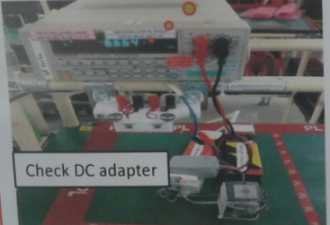
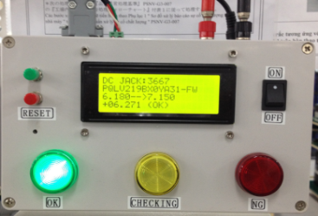
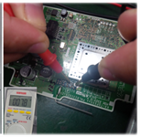
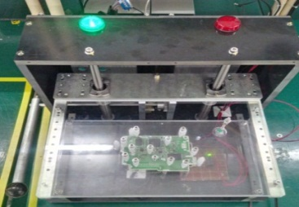
4. ACTION PLAN
7/10
■ Action2 ⇨ Ensure quality
Item
Action
Effective
Time
Actual product
◆ Auto inspection the AC adapter
An auto checker designed
- Auto judgemnt
- select models
- Visualization by lamp, sound
Quality
No mistake
Save time
8s/pcs
Apply
DP, DECT, PQC
Started
FEB
2015
E-Design
M-Design
OK
◆ Auto check antennal soldering
An auto checker designed
- Auto judgemnt
- Visualization by lamp, sound
Quality
No mistake
Save time
5s/pcs
Apply
All wireless model
APR
2015
E-Design
M-Design
OK
MACHINE NEVER MISTAKE AND NEVER TIRED
Notes:
The action number two: To ensure quality.
As you know, Human some time can mistake
But machine never mistake and also never tired.
So that is reason we want to apply machine
as much as possible for judgment process
With Main PSNV’s product is wireless model: DP, DECT
All of them have AC adapter, antenal.
Normaly, to check it we use DMM, and jugdment by worker
In 2015, we are plaining to make auto check and jugdment.
Actually, we already made 1 for DP, 1 for DECT phone and 1 for PQC.
We can ensure that no mistake and checking time will be reduced.
We will apply for all other model
Let me go to next page

Slide 8
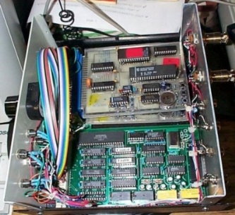
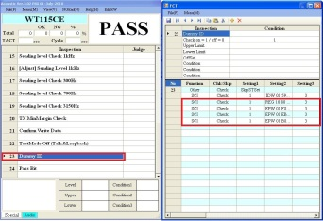
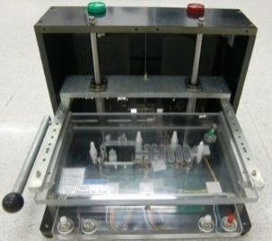
4. ACTION PLAN
8/10
■ Action3 ⇨ More made by PSNV
Details action |  | Expect save cost
1 | Make Control box for acoustic and ID writer | $2K/set
2 | Software programming | $15K /supporter & Software skill up
3 | Design and processing new kind of jig, checker | 50% price & Hardware skill up
Up to 95%
Localization
equipment
STANDARDIZE PSNV’S LOCAL EQUIPMENT
Notes:
Actually, more made in Viet nam is our target in last year,
Base on that thinking, many kind of JIG, checker was made by PSNV
And for this year, we continue to more increase localization.
We start to make control box, more software debug, and design
Target is 50% for electric and 95% for mechanic
We will standardize PSNV’s product,

Slide 9
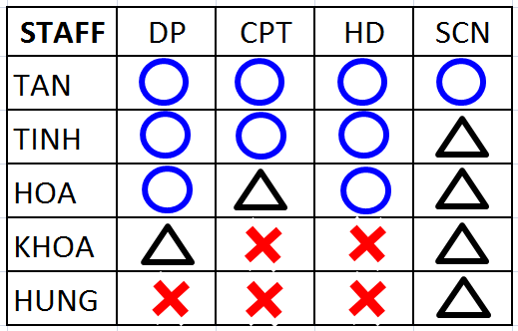
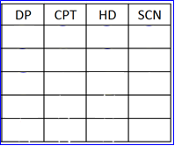
5. DEVELOPMENT PLAN
9/10
 Multi ability for staffs
STAFF ABILITY TABLE
TARGET
◆ PURPOSE:
1. Reduce stop line
2. Flexible in job assignment
◆ METHOD:
NOTE:
Professional
Good
Can do
Need to training
1. Study about PSNV product
2. Classify and Group staff
FY2014
4person
/1shift
3. Cross training / Rotation job
DP
PBX
…
SCN
AIO
CPT
DECT
HDC
◆ SCHEDULE:
PE
1 | Complete basic training | JUN.15 | B.Thang
2 | Cross training | OCT.15 | Each P.I.C
OCT
2015
3person
/1shift
3 | Multifunction for shift member | JUN.15 | SUP
4 | Exchange staff each team | OCT.15 | SUP
LET’S BECOME
“ALL IN ONE”
Notes:
In new position,
I not only control equipment but also manage PE-man power
So, I not only study for myself, but also train to my staff
Multi ability for staff is one of my target
To minimun stop line, all staff should have good skill and fast action
We must under stand about product and production,
Then understand about equipment.
So I built the staff ability table and target is full fill this table
And from October reduce 1 member in shift working.

Slide 10
5. DEVELOPMENT PLAN
10/10
 Details of study and training item
ACTION PLAN |  |  | FY2015
 |  |  | 2 | 3 | 4 | 5 | 6 | 7 | 8 | 9 | 2ndhalf
◆ Myself
 | Classify PE staff level to training Arrange daily, monthly schedule Investment control.
 | Study new model function New technology, new material.
 | Improve communication, presentation Study foreign language.
◆ My staffs
 |  | Equipment basic training Other category study
 |  | ISO documents follow-up Spare part, schedule 4M changing control
 |  | 5S-3T, safety, QCC activity
Plan
Done
Soft skill training by GA
Study management point from other Panasonic factory
Join the METALEX manufacturing show 8th ~ 10th OCT
Get N3 in July
Knowledge & Skill
Cross training
Problem solving
ISO Training
Follow up
QCC 1 team
5S-3T is daily activity
Notes:
And here is details of training item
For myself, in new position
I have to study more other category
But the most importan is understand well about PE staff level
Study new technology and find new equipment
which more cheaper and more full function.
Morever, have to improve my language skill
And my target is Japanese N3
For my staff, I have plan to training Basic knowledge of equipment, ISO
Always remind them: Safety is first, and 5S-3T is basic of every job,
In next year my target is set up minimum 1 QCC team

Slide 11
My slogan
QUICK RESPONSE – QUICK ACTION
Thank you for listening!
PSNV MAR.2015
Notes:
My slogan is Quick response, quick action
to bring the best service for production
Thank you for your listening,

